Slide 1
Team Member
إسراء سمير عبد القوي ابوزيد
اسماء رضا يحي عبدالوهاب
هناء سامح محمد نجم
ماري شريف سمير نجيب
مايفل مرقص وسيلي بولس

Slide 2
MACHINE LEARNING PROJECT · METRO INTERSTATE TRAFFIC VOLUME
Traffic Volume Prediction &
Congestion Classification System
A dual machine-learning pipeline — regression for hourly traffic volume and classification for congestion level — combined into a real-time decision support system.
Regression · Classification · Streamlit App · Decision Support

Slide 3

THE CHALLENGE
Problem Statement
Traffic volume on interstate roads is shaped by weather, time of day, day of the week, and holidays — yet commuters and traffic planners typically only find out how bad it is once they're already stuck in it.
Reactive, not predictive
Two questions, one dataset
Weather-linked disruption
Congestion is usually observed after it happens, leaving little room to plan around it.
Planners need both a numeric forecast (how many vehicles) and a simple label (how congested).
Rain, snow and fog visibly shift traffic patterns but aren't factored into daily planning.
02

Slide 4






GOALS
Project Objectives
Understand & clean the data
Engineer meaningful features
Profile the raw traffic-and-weather sensor data and resolve missing values, duplicates and outliers.
Derive time-based and categorical signals (hour, weekday, holiday, time-of-day period) from raw timestamps.
Predict traffic volume
Classify congestion level
Train and compare regression models to forecast hourly traffic_volume.
Train and compare classification models to label traffic as Low / Medium / High.
Tune the best model per task
Ship a usable interface
Apply hyperparameter search to the strongest regressor and classifier.
Combine both predictions into a single Streamlit decision-support app.
03

Slide 5
THE DATA
Dataset Overview
Metro_Interstate_Traffic_Volume_modified.csv — hourly interstate traffic sensor readings paired with weather observations.
48,204
13
2012 – 2018
Raw rows collected
Original columns
Date range covered
45,794
21
16
Rows after cleaning
Columns after feature engineering
Final model input features
Original columns:
date_time, temp, rain_1h, snow_1h, clouds_all, fog_mm, wind_speed_ms, flood_mm, holiday, weather_main, weather_description, day_type, traffic_volume
04

Slide 6
NOTEBOOK 01
Data Understanding
An automated ydata-profiling report was generated over the raw dataset to inspect types, missingness and distributions before any cleaning.
Column | Missing % | Notes
temp / rain_1h / snow_1h / clouds_all | ≈ 5.0% | Numeric sensor gaps
traffic_volume (target) | ≈ 5.0% | Rows dropped — cannot impute the target
holiday | 99.87% | Absence means "not a holiday", not missing data
fog_mm / wind_speed_ms / flood_mm / weather | 0% | Fully populated
38
Duplicate rows found (0.0%)
40,575
Unique timestamps of 48,204 rows
Key early finding: the dataset spans 6 years of hourly readings, but early columns show measurement gaps typical of long-running sensor logs — addressed in cleaning.
05

Slide 7

NOTEBOOK 02
Data Cleaning
Drop unlabeled rows
Removed the ~5% of rows missing the traffic_volume target — cannot be imputed reliably.
BEFORE → AFTER CLEANING
Median-fill sensor gaps
Rows
48,204
45,794
temp, rain_1h, snow_1h, clouds_all and flood_mm missing values filled with the column median.
Missing target rows
2,410
0
Recode holiday
99.87% missing holiday values recoded to the explicit category "No Holiday".
Missing holiday
48,143 (NaN)
0 ("No Holiday")
Parse timestamps
Duplicate rows
0
0
date_time converted from text to a proper datetime type for downstream feature extraction.
Outliers flagged (IQR)*
—
fog 14.2% · rain 6.8% · flood 6.8%
*Flagged via IQR for awareness — retained as legitimate weather extremes, not removed.
06

Slide 8
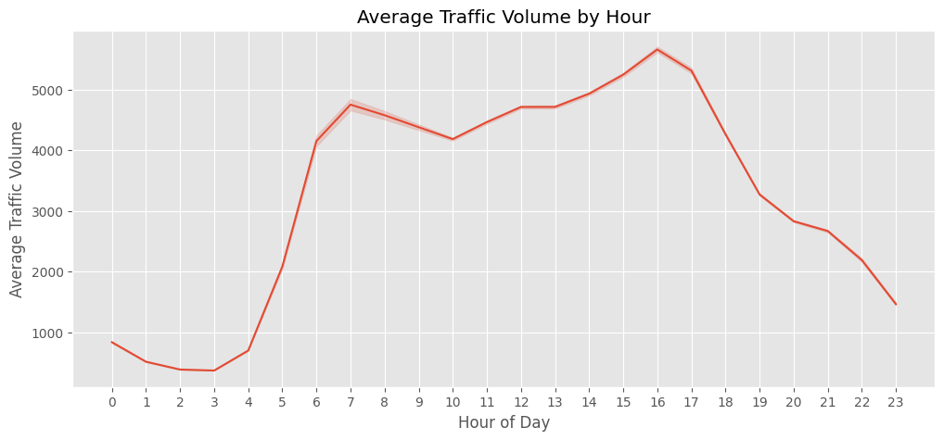
NOTEBOOK 03 · EDA
Traffic Follows the Clock
Averaging traffic_volume by hour of day reveals a strong, repeatable rush-hour signature — the single strongest time-based pattern in the dataset.
Clear morning peak and a taller afternoon/evening peak
Traffic troughs sharply overnight, between roughly midnight and 4 AM
This pattern directly motivated the hour and time_period engineered features
Average Traffic Volume by Hour of Day — real output, Notebook 03
07

Slide 9
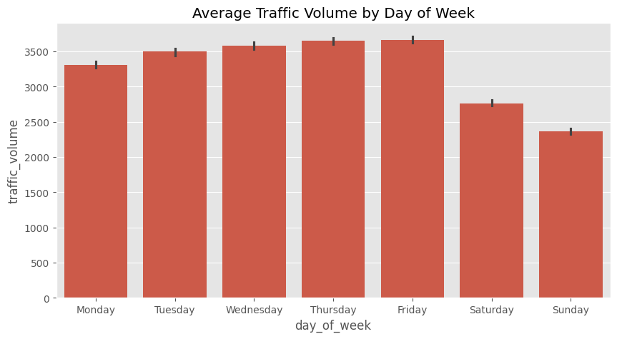
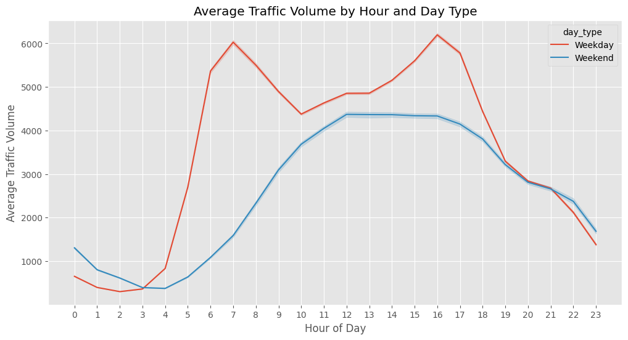
NOTEBOOK 03 · EDA
Weekday vs. Weekend Behavior
Average Traffic Volume by Day of Week
Traffic Volume by Hour, split by Day Type
Weekdays (Mon–Fri) show consistently higher average volume than Saturday and Sunday.
Weekdays show two sharp rush-hour peaks; weekends show one broader, flatter midday bulge.
08

Slide 10
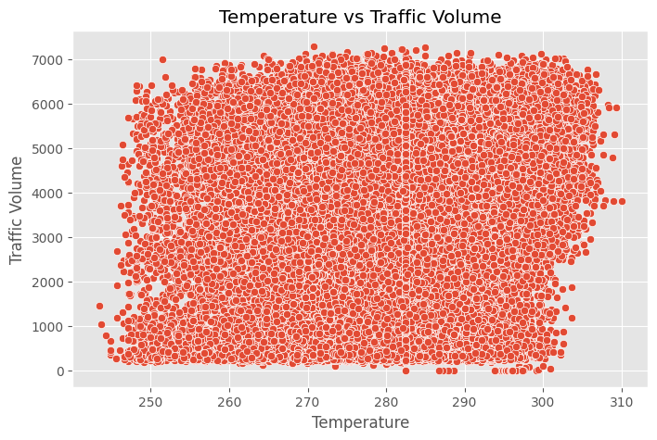
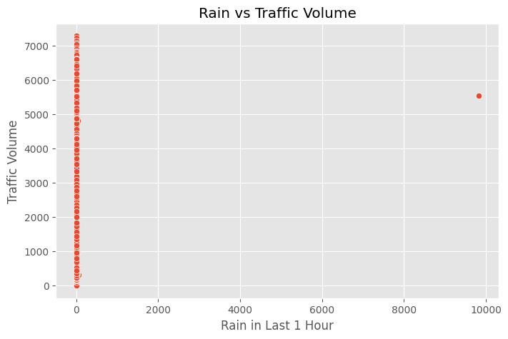
NOTEBOOK 03 · EDA
Does Weather Move Traffic?
Bivariate scatter plots of individual weather variables against traffic_volume — checked before deciding which features to engineer.
Temperature vs. Traffic Volume — no strong linear trend on its own, but useful combined with hour/season.
Rain (last hour) vs. Traffic Volume — most readings cluster at zero rain; volume varies widely regardless of rain amount.
09

Slide 11
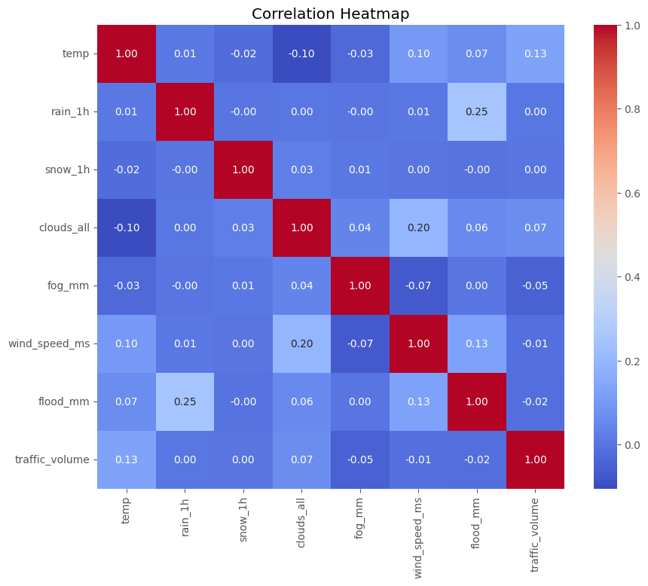
NOTEBOOK 03 · EDA
Correlation Analysis
Pairwise correlation between numeric features and traffic_volume, computed directly on the cleaned dataset.
No single weather variable correlates strongly with traffic_volume in isolation
This is exactly why time-based features (hour, day_of_week) and the OneHot-encoded categoricals carry most of the predictive signal
Confirms the modeling approach: tree-based models (Random Forest, XGBoost) that capture interactions outperform Linear/Logistic Regression
10

Slide 12
NOTEBOOK 04
Feature Engineering
New signals derived from date_time and traffic_volume — all saved to Data/traffic_feature_engineered.parquet (45,794 rows × 21 columns).
Feature | Logic | Distribution
hour, day_of_week, month, year | Extracted directly from date_time | 0–23 · 0–6 · 1–12 · 2012–2018
is_weekend | 1 if Saturday/Sunday, else 0 | 32,777 weekday · 13,017 weekend
is_holiday | 1 if holiday ≠ "No Holiday" | 45,736 no · 58 yes
time_period | Binned from hour | Morning 11,699 · Night 11,647 · Afternoon 9,258 · Evening 7,467 · Late_Night 5,723
congestion_level (target) | traffic_volume split into 3 equal-frequency bins (pd.qcut) | Low 15,266 · Medium 15,265 · High 15,263
weather_description was also normalized: lower-cased and stripped of extra whitespace.
11

Slide 13
NOTEBOOKS 05 & 06
Preprocessing Pipeline
Both tasks share an identical time-based split and an identical ColumnTransformer structure, fit separately for each target.
→
→
→
16 Raw Features
StandardScaler
OneHotEncoder
66 Model-Ready Features
13 numeric + 3 categorical
applied to numeric features
handle_unknown='ignore' on holiday, weather_description, time_period
saved as *_preprocessor.pkl
38,257 / 7,537
66
2 pipelines
Train / test rows (time-based split: train < 2018, test = 2018)
Processed feature columns after scaling + one-hot encoding
regression_preprocessor.pkl · classification_preprocessor.pkl
12

Slide 14
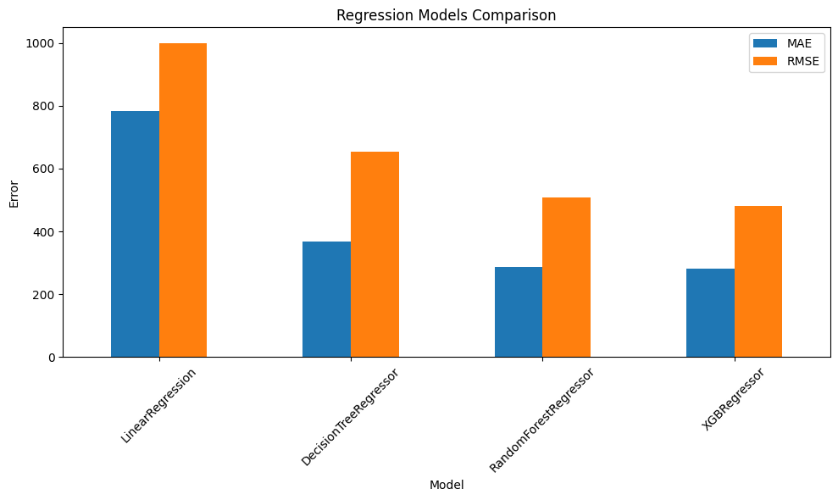
NOTEBOOK 07
Regression Models Compared
Baseline DummyRegressor (mean strategy): MAE 1,728.06 · RMSE 1,973.94 · R² ≈ 0 — every model below beats it decisively.
Model | MAE | RMSE | R²
Linear Regression | 782.53 | 999.57 | 0.7436
Decision Tree | 366.52 | 654.13 | 0.8902
Random Forest | 287.69 | 506.78 | 0.9341
XGBoost | 280.06 | 480.67 | 0.9407
XGBoost wins on every metric — selected for hyperparameter tuning.
MAE / RMSE across the four candidate models — real chart, Notebook 07
13

Slide 15
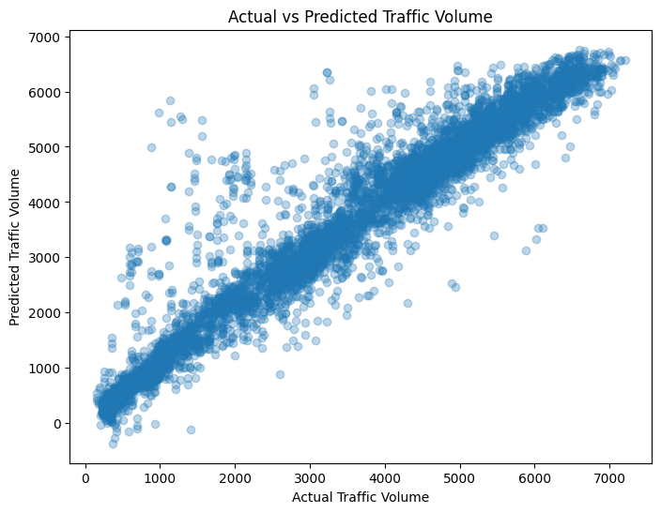
NOTEBOOK 07 · TUNING
Final Regression Model
278.06
486.61
0.9392
MAE (test set)
RMSE (test set)
R² (test set)
Tuned via RandomizedSearchCV (10 iterations, 3-fold CV, scoring = neg_root_mean_squared_error). Best parameters:
subsample=0.9 · n_estimators=100 · min_child_weight=3 · max_depth=5 · learning_rate=0.1 · gamma=0.1 · colsample_bytree=1.0
XGBoost: Actual vs. Predicted Traffic Volume (test set)
Saved to Models/best_xgb_reg.pkl — the exact model loaded by the Streamlit app.
14

Slide 16
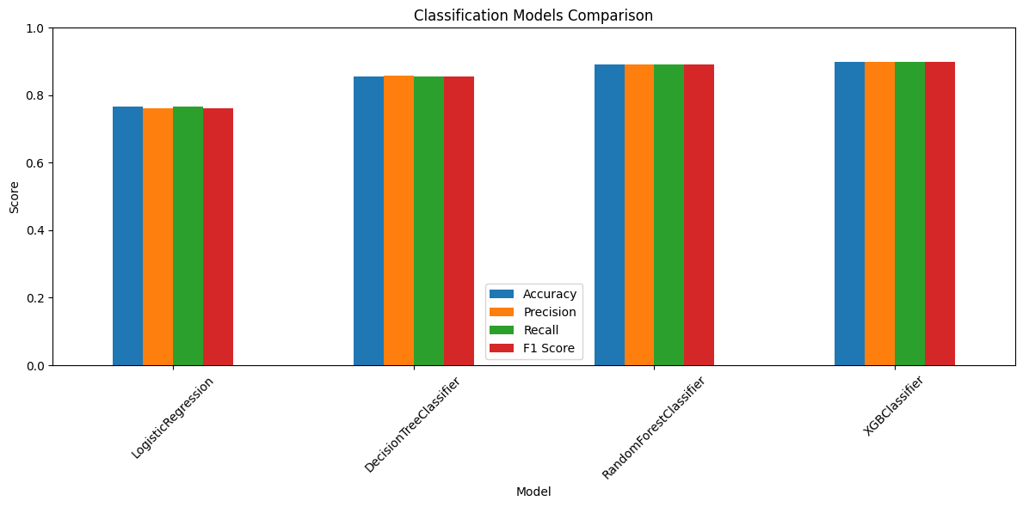
NOTEBOOK 08
Classification Models Compared
Baseline (majority-class prediction): Accuracy 0.3328 — a random/naive guess on 3 balanced classes.
Model | Accuracy | Precision | Recall | F1
Logistic Regression | 0.7657 | 0.7610 | 0.7657 | 0.7624
Decision Tree | 0.8547 | 0.8574 | 0.8547 | 0.8557
Random Forest | 0.8901 | 0.8919 | 0.8901 | 0.8903
XGBoost | 0.8981 | 0.8998 | 0.8981 | 0.8984
Accuracy / Precision / Recall / F1 across candidates — real chart, Notebook 08
XGBoost again wins on every metric — selected for hyperparameter tuning.
15

Slide 17
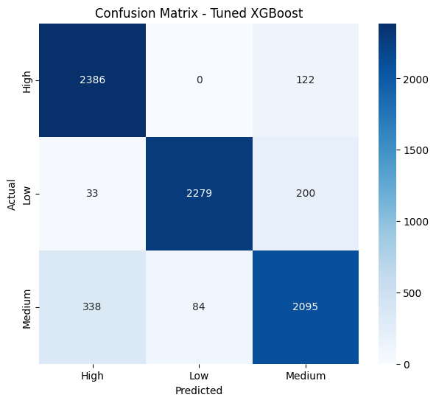
NOTEBOOK 08 · TUNING
Final Classification Model
89.7%
0.899
0.897
Accuracy (test set)
Precision (weighted)
F1 Score (weighted)
Tuned via RandomizedSearchCV (20 iterations, 3-fold CV, scoring = f1_weighted). Best parameters:
subsample=0.7 · n_estimators=500 · max_depth=3 · learning_rate=0.05 · colsample_bytree=0.7
Confusion matrix — tuned XGBoost classifier (test set)
Saved to Models/best_xgb_cls.pkl, alongside classification_label_encoder.pkl mapping classes back to High / Low / Medium.
16

Slide 18
NOTEBOOKS 07 & 08
Hyperparameter Tuning
Both final models used RandomizedSearchCV over an XGBoost estimator — search space chosen per task's scoring goal.
Regression — XGBRegressor
Classification — XGBClassifier
Search size
10 iterations × 3-fold CV
Search size
20 iterations × 3-fold CV
Scoring
neg_root_mean_squared_error
Scoring
f1_weighted
Best CV RMSE
512.91
Best CV F1
0.887
subsample
0.9
subsample
0.7
n_estimators
100
n_estimators
500
min_child_weight
3
max_depth
3
max_depth
5
learning_rate
0.05
learning_rate
0.1
colsample_bytree
0.7
gamma
0.1
colsample_bytree
1.0
17

Slide 19
SYSTEM ARCHITECTURE
Final ML Pipeline
Regression Preprocessor
Classification Preprocessor
User Input
(date, hour, weather...)
→
↓
↓
Tuned XGBoost Regressor
Tuned XGBoost Classifier
↓
↓
🚗 Predicted Traffic Volume
Label Encoder
↓
🚦 Predicted Congestion Level
🧭 Decision Support System — plain-language traffic recommendation
18

Slide 20
DELIVERABLE 1
The Streamlit Application
app.py is a thin, read-only interface over the artifacts already saved to Models/ — it never retrains or fabricates a prediction.
Application Pages
🚦 Traffic Volume Prediction & Congestion Classification
🏠
Home / Prediction
Sidebar inputs → both predictions + recommendation
📥 Input Features
Date · Hour · Holiday · Temperature · Rain · Snow · Cloud coverage · Fog · Wind speed · Flood level · Weather description
📊
Prediction Results
Persists the last run's inputs and outputs
🤖
Model Information
🚗 Predicted Traffic Volume
5,702 vehicles/hour
🚦 Predicted Congestion Level
Medium
Algorithms, metrics and hyperparameters for both tasks
📁
About the Project
Explains the pipeline and what the app does / doesn't do
Illustrative mockup of the live app — actual values depend on the inputs entered.
Resilient by design: if any model file is missing, the app shows a clear warning instead of an invented prediction.
19

Slide 21
DELIVERABLE 1
How a Prediction Happens
1
2
3
4
Enter conditions
Derive time features
Run both pipelines
Read the result
→
→
→
Date, hour, holiday and weather values entered in the sidebar.
day_of_week, month, year, is_weekend, is_holiday and time_period computed automatically.
The same input row is transformed by each ColumnTransformer and scored by each model.
Volume + congestion level are shown together with a plain-language recommendation.
20

Slide 22
NOTEBOOK 09
Decision Support System
The regression and classification outputs are combined into a single plain-language recommendation — logic copied verbatim into app.py.
Congestion: High
Congestion: Medium
Congestion: Low
🔴
🟠
🟢
Avoid peak hours or consider an alternative route.
Expect moderate delays and allow extra travel time.
Traffic conditions are favorable.
21

Slide 23


WHAT'S NEXT
Future Improvements
Wider hyperparameter search
Model explainability
Expand the RandomizedSearchCV space and iteration count for both tasks.
Add SHAP-based feature importance directly inside the Streamlit app.
Single canonical model source
Real-time weather feed
Persist the "final" model variables from Notebook 09 so there is one unambiguous source of truth per task.
Replace manual weather entry with a live weather API call.
22

Slide 24
WRAP-UP
Conclusion
R² 0.9392
89.7% Accuracy
Tuned XGBoost explains ~94% of test-set traffic volume variance
Tuned XGBoost congestion classifier (F1 ≈ 0.897)
16 → 66
1 App
Raw features expanded to model-ready features via preprocessing
Both predictions unified into one Streamlit decision-support tool
Time-based features and weather conditions drive both tasks — consistent with the EDA findings throughout this project.
23

Slide 25
Questions & Discussion
Metro Interstate Traffic Volume — Prediction & Congestion Classification System
Thank you

